Slide 1


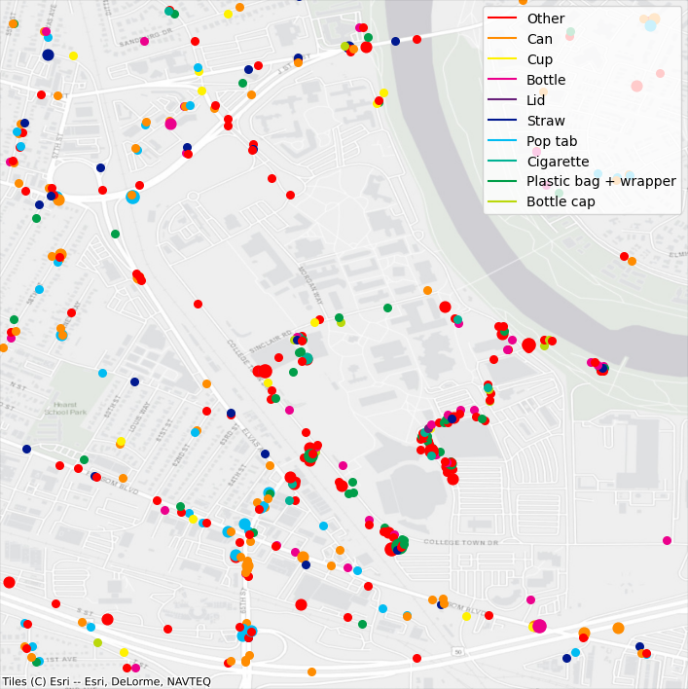
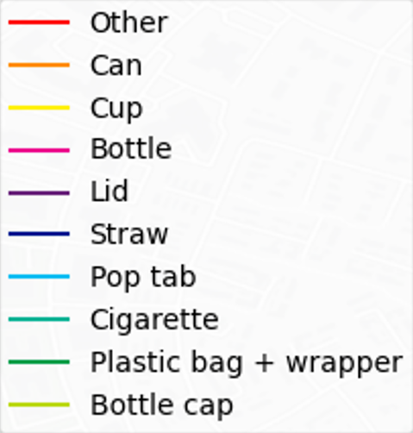
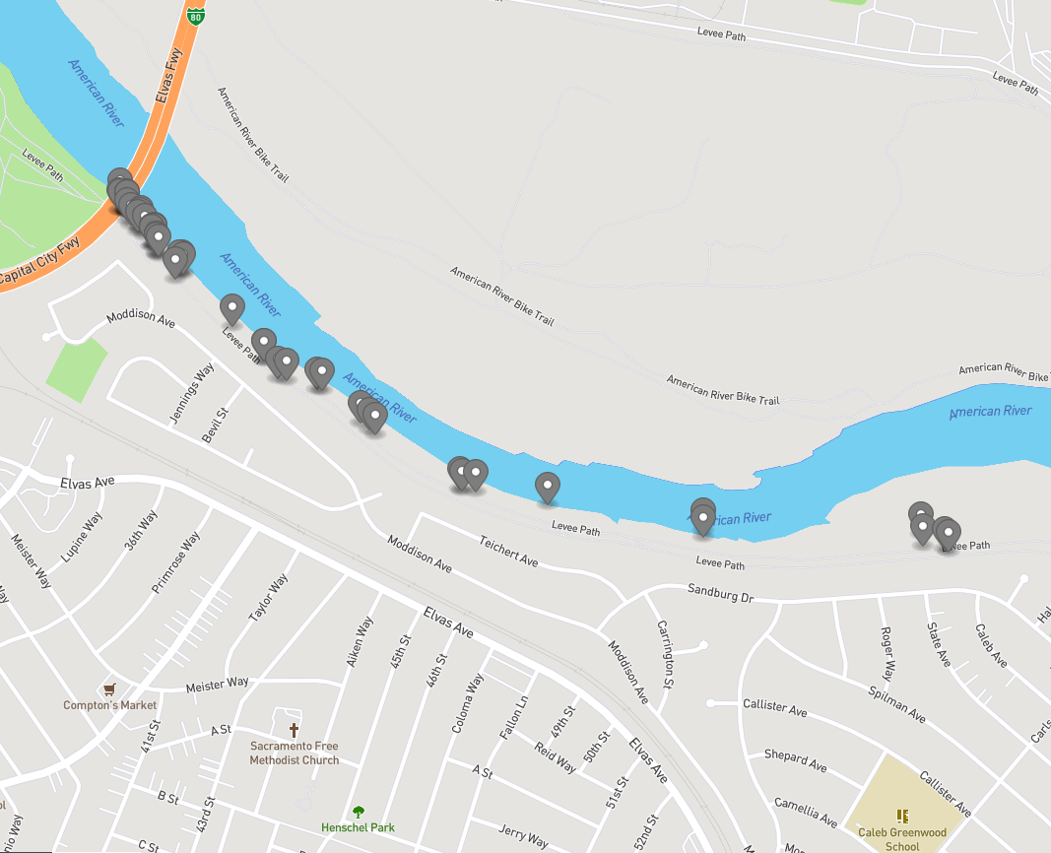
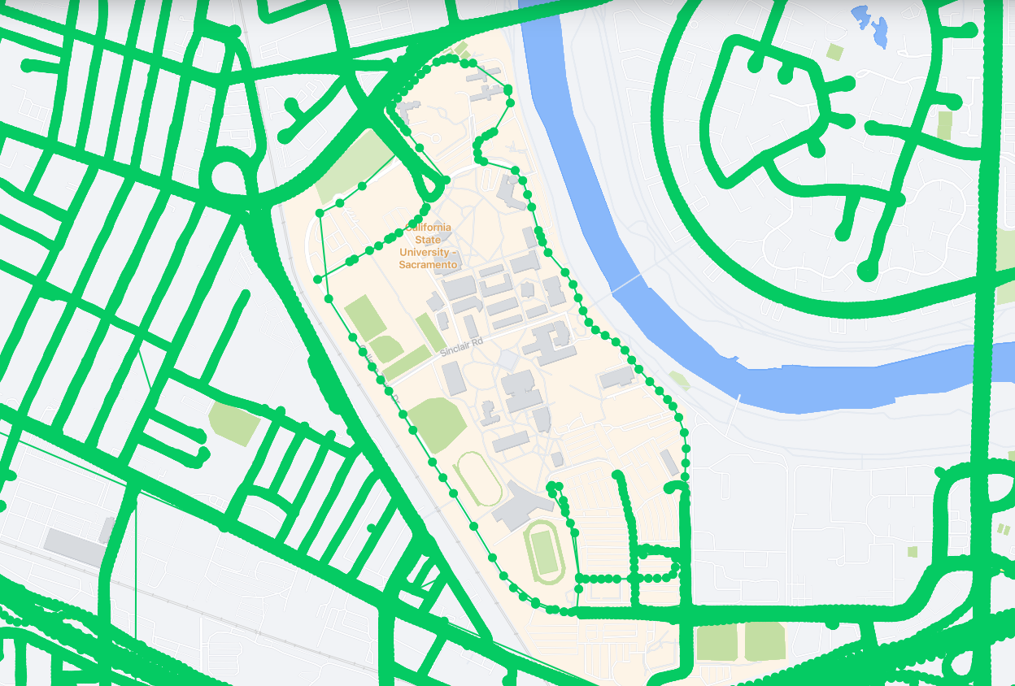
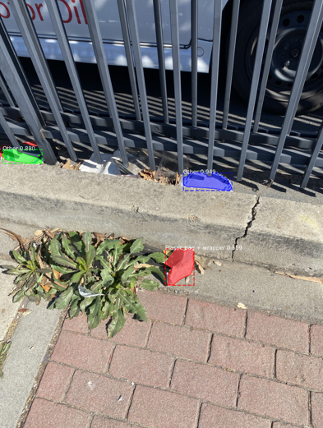
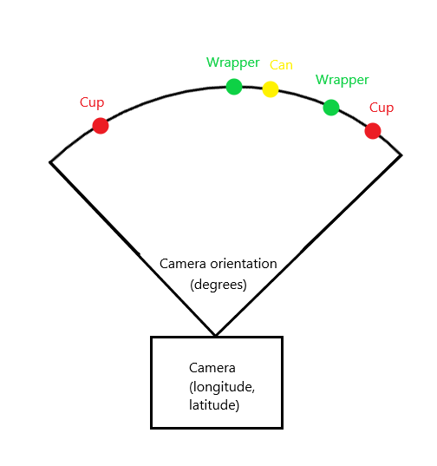
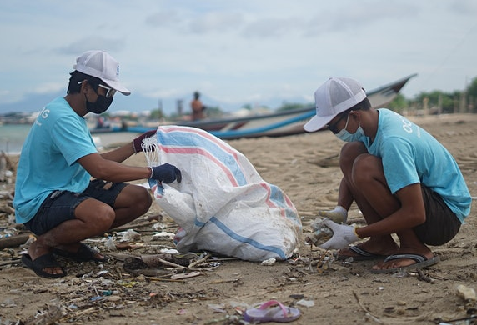
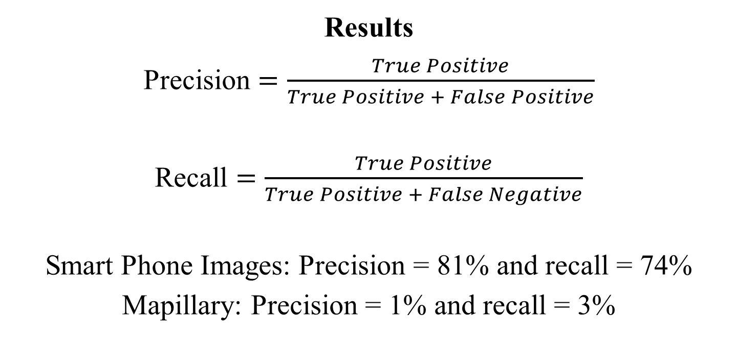
Searching for Uncollected Litter with Computer Vision
Julian Hernandez
Faculty Mentor: Dr. Fitzgerald
California State University, Sacramento
Abstract
This study combines photo metadata and computer vision to quantify where uncollected litter is present. A pretrained model from the Trash Annotations in Context (TACO) dataset classified objects in 10 categories of garbage. Although it worked well with smartphone photos, it struggled when trying to process images from vehicle mounted cameras. However, increasing the variety of perspectives and backgrounds in the dataset will help it improve in unfamiliar situations. These data are plotted onto a map which, as accuracy improves, could be used for measuring waste management strategies and quantifying trends.
Problem
Trash production is doubling every decade
Only 10% of plastic is recycled
Waste produces 5% of global GHG emissions
80% of marine litter originates on land
Litter Estimates
Current methods to evaluate litter levels trade accuracy for time, how can this challenge be overcome?
Research Question
Can computer vision help identify new areas that need to be cleanup and measure how much waste is removed?
Methods
Algorithm: Mask R-CNN
Training dataset: Trash Annotations in Context
Detection datasets: Mapillary & smart-phone images
Results
Precision $=\frac{True Positive}{True Positive + False Positive}$
Recall $=\frac{True Positive}{True Positive + False Negative}$
Smart Phone Images: Precision = 81% and recall = 74%
Mapillary: Precision = 1% and recall = 3%
Challenges
Low quality images increase noise
Solution: Minimum 1080p
Overfit algorithm
Solution: Collect a diverse set of images
New backgrounds causing lots of false positives
Solution: Add a new category ‘not trash’ with pictures of cars
Future Work
Increase TACO images -> higher accuracy
Divert recycling out of landfills during the American River Parkway Cleanup
Conclusion
For car mounted camera detection many more images are needed
Smart phone images can be used to estimate litter amounts
References available upon request from julianhernandez@csus.edu

